Slide 1

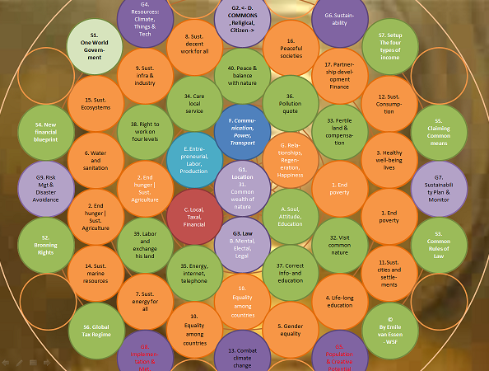


The Global Agenda Shift
World Sustainability Fund
Sustainable Regeneration
Zero Marginal Cost Society
U.N. Post 2015 Agenda
Bronning, Commons, Labor, Taxation, and Finance
Emile van Essen - WSF
< Play intro, 1 minute

Slide 2
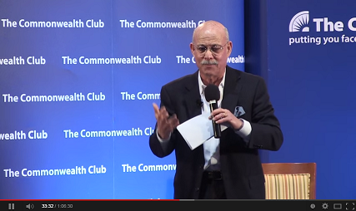
Jeremy Rifkin
Zero Marginal Cost Society
Industrial Revolution is based on
Communication, Power, and Transport.
Next stadium:
3.0 (Intergrids) Internet, Renewable Energy, Automation and Sensor driven Transport and Logistics.
worldsustainabilityfund.nl
Play intro >

Slide 3
My vision delivers a 7x3 string of interconnectivities:
On the Extended Triads including:
A. Soul, Attitude, Education,
B. Mental, Electal, Legal,
C. Local, Taxal, Financial,
<- Royal | Democratic, Religical, Citizen ->, = D.
E. Entrepreneurial, Labor, Production,
F. Communication, Power, Transport,
G. Relationships, Regeneration, Happiness.
worldsustainabilityfund.nl

Slide 4
And specifices several more Stadia of (Industrial) Revolution:
0.3 Speech, Hunting, Bear Stick;
0.5 Scripture, Farmfield, Horse;
0.7 Dove, Wood | Grain & Cattle, Horses cart;
1.0 Steam Book Press, Coal, Steam Locomotive;
2.0 Telegraph (Centralised Communication), Fossil Fuel, Combustion Engine;
3.0 (Intergrids) Internet, Renewable Energy, Automation and Sensor driven Transport and Logistics;
4.0 (Abundance Grids) 3.0 WILL EFFECT AND TOTALY CHANGE the tritspowers A. to G.
5.0 (Creagrids) Natural Singularity, Energy Popup, Super Local Transport;
worldsustainabilityfund.nl

Slide 5
Zero Marginal Cost Society
1.0 Steam Book Press, Coal, Steam Locomotive
2.0 Telegraph, Fossil Fuel, Combustion Engine
3.0 (Intergrids) Internet, Renewable
Energy, Sensor driven Transport
and Logistics
4.0 (Abundance Grids) 3.0 WILL
EFFECT AND TOTALY CHANGE
the tritspowers A. to G.
5.0 (Creagrids) Natural
Singularity, Energy Popup,
Super Local Transport
F. Commu-nication, Power, Transport
E. Entre-preneurial, Labor, Production
G. Rela-tionships, Regen-eration, Happiness
<- D. Democratic, Religical,
Citizen ->
C. Local, Taxal, Financial
A. Soul, Attitude, Education
B. Mental, Electal, Legal
commonsabundance.net
GaiaField Project
we.net
worldsustainabilityfund.nl

Slide 6
CHANGES in the triad powers
G. Relationships, Regeneration, Happiness:
3.0 Intergrids will optimize relationships, exchange regeneration & change happiness indicators;
5.0 Creagrids will optimize population numbers, longevity, transport vortexes;
F. Communication, Power, Transport;
E. Entrepreneurial, Labor, Production
3.0 Prosumers, Four layer "Bitcoin" taskgrid (Self care, Informal care, Infrasocial, and free "capitalist" creations), BioElectroRoboChemical human production shift;
D. <- Royal, Religical, Citizen ->
From Democratic to Commons Governance,
Intra-Omni-Science-Religial, World Citizen;
worldsustainabilityfund.nl

Slide 7
CHANGES in the triad powers
C. Local, Taxal, Financial:
A livable piece of land for each human being and species, Tax becomes 80/20 "Bitcoin" taskgrid, global labor prices | Zero Marginal Cost to resource tax based economy;
B. Mental, Electal, Legal:
Stressless desire, Internet Elections for Global Development and Governance, Simple Global Rules of Law;
A. Soul, Attitude, Education:
Arrival / Birth of Next Level of Indigo-Crystal Inter-Galaxtic Souls, Open minded for new visions, intergrid self directed super study.
worldsustainabilityfund.nl

Slide 8

Sustainability Development Goals
1. End poverty in all its forms everywhere
2. End hunger, achieve food security and improved nutrition, and promote sustainable agriculture
3. Ensure healthy lives and promote well-being for all at all ages
4. Ensure inclusive and equitable quality education and promote life-long learning opportunities for all
5. Achieve gender equality and empower all women and girls
6. Ensure availability and sustainable management of water and sanitation for all
7. Ensure access to affordable, reliable, sustainable, and modern energy for all
8. Promote sustained, inclusive and sustainable economic growth, full and productive employment and decent work for all
9. Build resilient infrastructure, promote inclusive and sustainable industrialization and foster innovation
worldsustainabilityfund.nl

Slide 9
For the U.N. Post 2015 Agenda
10. Reduce inequality within and among countries
11. Make cities and human settlements inclusive, safe, resilient and sustainable
12. Ensure sustainable consumption and production patterns
13. Take urgent action to combat climate change and its impacts
14. Conserve and sustainably use the oceans, seas and marine resources for sustainable development
15. Protect, restore and promote sustainable use of terrestrial ecosystems, sustainably manage forests, combat desertification, and halt and reverse land degradation and halt biodiversity loss
16. Promote peaceful and inclusive societies for sustainable development, provide access to justice for all and build effective, accountable and inclusive institutions at all levels
17. Strengthen the means of implementation and revitalize the global partnership for sustainable development Finance
worldsustainabilityfund.nl

Slide 10
The 17 SDGs - Post 2015 Sustainability Development Goals
8. Sust. decent work for all
17. Partner-ship devel-opment Finance
9. Sust. infra & industry
16. Peaceful societies
3. Healthy well-being lives
15. Sust. Ecosystems
14. Sust. marine resources
2. End hunger | Sust. Agriculture
13. Combat climate change
1. End poverty
12. Sust. Consump-tion
11.Sust. cities and settle-ments
6. Water and sanitation
10.
Equality
among
countries
5. Gender equality
7. Sust. energy for all
4. Life-long education
worldsustainabilityfund.nl

Slide 11
16. Peaceful societies
SDGs surround ZMCS
13. Combat climate change
Federal COMMONS Governance
Shift form older politic systems to ~
15. Sust. Ecosystems
8. Sust. decent work for all
17. Partner-ship devel-opment Finance
12. Sust. Consump-tion
9. Sust. infra & industry
F. Commu-nication, Power, Transport
3. Healthy well-being lives
E. Entre-preneurial, Labor, Production
G. Rela-tionships, Regen-eration, Happiness
2. End hunger | Sust. Agriculture
<- D. COMMONS, Religical,
Citizen ->
1. End poverty
Focus Shift Mantra
worldsustainabilityfund.nl
C. Local, Taxal, Financial
A. Soul, Attitude, Education
6. Water and sanitation
B. Mental, Electal, Legal
5. Gender equality
14. Sust. marine resources
7. Sust. energy for all
4. Life-long education
11.Sust. cities and settle-ments
10.
Equality
among
countries
SDGs - Post 2015 Sustain-
ability Development Goals
ZMCS –
Zero Marginal Cost Society

Slide 12

Bronning
The art of surrounding life with regeneration (and wealth) sources
. Finance as only source for existence
. Work as source for finance: Artificial regeneration
. Nature is the real source
. A piece of nature and water, food and energy as birth right
. Free income from commons sources
worldsustainabilityfund.nl

Slide 13
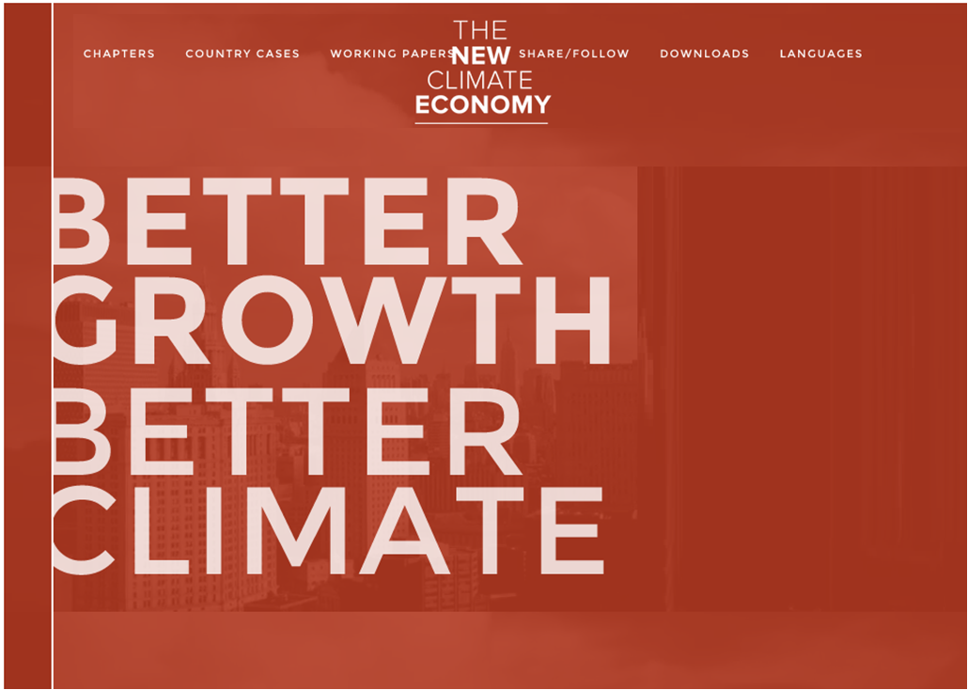
Play intro AND close it to come back to this presentation >
Click

Slide 14
Human Rights - basic info
In 1948 the United Nations adopted the Universal Declaration of the Human Rights. It contains 30 rights.
In 2010 Emile van Essen proposed to add 10 Sustainable Human Rights to implement Bronning.
worldsustainabilityfund.nl

Slide 15
In short Human Rights handles:
1. FREEDOM AND EQUALTY
2. RECOGNITION AND LAW
3. FREEDOM OF MOVEMENT AND NATIONALITY
4. MARRIAGE AND FAMILY
5. PROPERTY, THOUGHT, ASSOCIATION AND GOVERNMENT
6. SOCIAL SECURITY, EMPLOIMENT AND REMUNERATION
7. STANDARD LIVING AND EDUCATION
8. CULTURAL PARTICIPATION AND CREATIVE OWNERSHIP
9. SOCIAL AND COMMUNITY DUTIES
10. SUSTAINABLE ECOSYSTEMS AND LIVING
worldsustainabilityfund.nl

Slide 16
The Ten Bronning Rights
31. A part of the global land and water will be common wealth to ensure sustainability of nature and species.
32. Everyone has the right to visit (parts of) common nature.
33. Everyone gets (for instance) 1.000 m2 of fertile land on which enough sun and water enters to produce good food, healthy living, and land value difference compensation.
34. Everyone gets the right and duty to get and give care to the commons and peoples with inabilities and at age as a local service – part of lifetime activity.
35. Everyone gets free energy in an reasonable amount to has good light, heating and cooling, cleaning, internet, and telephone.
36. Everyone gets a pollution quote and the right on healthy air and surrounding.
worldsustainabilityfund.nl

Slide 17
37. Everyone has the right on correct information and sufficient education.
38. Everyone has the right to work on four levels – based on green technology: On his own land; On community services;
On social services; On commercial services.
39. Everyone has the right to (let) labor his land, build a house on it and to exchange with others. After dying the land may stay for max. five year in the family. Then it will be free for giving it away to the community which will give it to a new born child.
40. Mankind has the right to live in peace and harmony with nature by finding together the right proportions for the above by becoming aware of interrelationships as popula-tion, food, rich natural environment, and the needed spiritual emotional balance.
worldsustainabilityfund.nl

Slide 18
Bronning Rights
40. Peace & balance with nature
31. Common wealth of nature
32. Visit common nature
33. Fertile land & compensation
34. Care local service
35. Energy, internet, telephone
36. Pollution quote
37. Correct info- and education
38. Right to work on four levels
39. Labor and exchange his land
40. Peace & balance with nature
8. Sust. decent work for all
17. Partner-ship devel-opment Finance
9. Sust. infra & industry
34. Care local service
3. Healthy well-being lives
32. Visit common nature
35. Energy, internet, telephone
38. Right to work on four levels
31. Common wealth of nature
39. Labor and exchange his land
36. Pollution quote
33. Fertile land & compensa-tion
6. Water and sanitation
37. Correct info- and education
5. Gender equality
7. Sust. energy for all
4. Life-long education
worldsustainabilityfund.nl

Slide 19
<- D. COMMONS, Religical,
Citizen ->
ZMCS, BR, SDG
8. Sust. decent work for all
16. Peaceful societies
9. Sust. infra & industry
40. Peace & balance with nature
17. Partner-ship devel-opment Finance
15. Sust. Ecosystems
34. Care local service
36. Pollution quote
12. Sust. Consump-tion
38. Right to work on four levels
F. Commu-nication, Power, Transport
33. Fertile land & compensa-tion
6. Water and sanitation
E. Entre-preneurial, Labor, Production
G. Rela-tionships, Regen-eration, Happiness
3. Healthy well-being lives
2. End hunger | Sust. Agriculture
31. Common wealth of nature
1. End poverty
Focus Shift Merkaba
2. End hunger | Sust. Agriculture
C. Local, Taxal, Financial
A. Soul, Attitude, Education
1. End poverty
39. Labor and exchange his land
B. Mental, Electal, Legal
32. Visit common nature
14. Sust. marine resources
35. Energy, internet, telephone
37. Correct info- and education
11.Sust. cities and settle-ments
7. Sust. energy for all
10.
Equality
among
countries
4. Life-long education
10.
Equality
among
countries
5. Gender equality
13. Combat climate change
worldsustainabilityfund.nl

Slide 20
GLOS
Geographical Layers Of Sustainability
1. Location
2. Governance
3. Law
4. Resources: Climate, Vegetations, Raw materials, Technology, and Created Assets
5. Population and Creative Potential
6. Sustainability
7. Sustainability Plan, Feasibility and Monitor
8. Implementation and Management
9. Risk, Disaster Avoidance, and Disaster Emergency
worldsustainabilityfund.nl

Slide 21
Geographical Layers Of Sustainability
40. Peace & balance with nature
G1. Location
G2. Governance
G3. Law
G4. Resources: Climate, Things & Tech
G5. Population & Creative Potential
G6. Sustainability
G7. Sustainability Plan & Monitor
G8. Implementation & Management
G9. Risk Mgt & Disaster Avoidance
8. Sust. decent work for all
17. Partner-ship devel-opment Finance
9. Sust. infra & industry
G2. Govern-ance
3. Healthy well-being lives
G4. Resources: Climate, Things & Tech
G6. Sustain-ability
G9. Risk Mgt & Disaster Avoidance
G1. Location
G7. Sustainability Plan & Monitor
G8. Implemen-tation & Mgt.
G5. Population & Creative Potential
6. Water and sanitation
G3. Law
5. Gender equality
7. Sust. energy for all
4. Life-long education
worldsustainabilityfund.nl

Slide 22
G4. Resources: Climate, Things & Tech
G2. <- D. COMMONS, Religical,
Citizen ->
G6. Sustain-ability
ZMCS, BR, SDG, GLOS
1
8. Sust. decent work for all
16. Peaceful societies
1
9. Sust. infra & industry
40. Peace & balance with nature
17. Partner-ship devel-opment Finance
15. Sust. Ecosystems
34. Care local service
36. Pollution quote
12. Sust. Consump-tion
1
38. Right to work on four levels
F. Commu-nication, Power, Transport
33. Fertile land & compensa-tion
1
6. Water and sanitation
E. Entre-preneurial, Labor, Production
G. Rela-tionships, Regen-eration, Happiness
3. Healthy well-being lives
G9. Risk Mgt & Disaster Avoidance
2. End hunger | Sust. Agriculture
G1. Location 31. Common wealth of nature
1. End poverty
G7. Sustainability Plan & Monitor
Focus Shift Merkaba
2. End hunger | Sust. Agriculture
C. Local, Taxal, Financial
A. Soul, Attitude, Education
1. End poverty
1
39. Labor and exchange his land
G3. Law
B. Mental, Electal, Legal
32. Visit common nature
1
14. Sust. marine resources
35. Energy, internet, telephone
37. Correct info- and education
11.Sust. cities and settle-ments
7. Sust. energy for all
10.
Equality
among
countries
4. Life-long education
1
10.
Equality
among
countries
5. Gender equality
1
G8. Implemen-tation & Mgt.
13. Combat climate change
G5. Population & Creative Potential
worldsustainabilityfund.nl

Slide 23
Federal Commons
Federal: Like feathers, and tree branches
Commons: Sharing ownership and responsibility, like People on one world
Federal Commons Governance:
  One World Government
  Continents
  Countries
  Provinces
  Municipalities
  Cities/Villages
  Local common spheres/Private spheres
worldsustainabilityfund.nl

Slide 24
Common Goods
Planet Earth
Biosphere, mass, living creatures
Waters and air
Earth, elements, minerals, gasses and fuels
Common fields, infrastructure, and buildings
Culture, knowledge, heritage
Telephony, internet, and free software
Wind, sunshine, thermal and water energy
worldsustainabilityfund.nl

Slide 25
Common problem
Climate change: Primary existence
Overpopulation: Leads to scarcity and wars
Unequal possession: Of survival means like land, water, food, seeds, animals, …
Income and work: Automatisation, Labor price inequality, 6% average unemployment manipulation
Health, education, and welfare
worldsustainabilityfund.nl

Slide 26
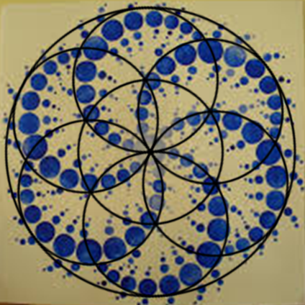
Shift to Federal Commons
S1. Election of One World Government
S2. Declaration of Bronning Rights
S3. Common Rules of Law to speed up SDGs
S4. Develop a new global financial blueprint
S5. Claiming Common means and compensation
S6. Global Tax Regime
S7. Setup The four types of income
worldsustainabilityfund.nl

Slide 27
Shift to Federal Commons
40. Peace & balance with nature
S1. One World Government
S2. Bronning Rights
S3. Common Rules of Law
S4. New financial blueprint
S5. Claiming Common means
S6. Global Tax Regime
S7. Setup The four types of income
8. Sust. decent work for all
17. Partner-ship devel-opment Finance
9. Sust. infra & industry
S2. Bronning Rights
3. Healthy well-being lives
S4. New financial blueprint
S5. Claiming Common means
G9. Risk Mgt & Disaster Avoidance
S1.
One World Govern-ment
G7. Sustainability Plan & Monitor
S6. Global Tax Regime
S7. Setup The four types of income
6. Water and sanitation
S3. Common Rules of Law
5. Gender equality
7. Sust. energy for all
4. Life-long education
worldsustainabilityfund.nl

Slide 28
8. Sust. decent work for all
8. Sust. decent work for all
8. Sust. decent work for all
G4. Resources: Climate, Things & Tech
G2. <- D. COMMONS, Religical,
Citizen ->
G6. Sustain-ability
ZMCS, BR, SDG,
GLOS to Federal Commons
1
S1.
One World Govern-ment
1
8. Sust. decent work for all
16. Peaceful societies
S7. Setup The four types of income
8. Sust. decent work for all
9. Sust. infra & industry
40. Peace & balance with nature
17. Partner-ship devel-opment Finance
8. Sust. decent work for all
15. Sust. Ecosystems
34. Care local service
36. Pollution quote
12. Sust. Consump-tion
1
38. Right to work on four levels
F. Commu-nication, Power, Transport
33. Fertile land & compensa-tion
S4. New financial blueprint
1
S5. Claiming Common means
6. Water and sanitation
E. Entre-preneurial, Labor, Production
G. Rela-tionships, Regen-eration, Happiness
3. Healthy well-being lives
G9. Risk Mgt & Disaster Avoidance
2. End hunger | Sust. Agriculture
G1. Location 31. Common wealth of nature
1. End poverty
G7. Sustainability Plan & Monitor
Focus Shift Merkaba
2. End hunger | Sust. Agriculture
C. Local, Taxal, Financial
A. Soul, Attitude, Education
1. End poverty
1
G3. Law
B. Mental, Electal, Legal
S2. Bronning Rights
1
39. Labor and exchange his land
32. Visit common nature
S3. Common Rules of Law
14. Sust. marine resources
35. Energy, internet, telephone
37. Correct info- and education
11.Sust. cities and settle-ments
8. Sust. decent work for all
7. Sust. energy for all
10.
Equality
among
countries
4. Life-long education
8. Sust. decent work for all
S6. Global Tax Regime
10.
Equality
among
countries
5. Gender equality
1
©
By Emile van Essen
- WSF
G8. Implemen-tation & Mgt.
13. Combat climate change
G5. Population & Creative Potential
worldsustainabilityfund.nl
8. Sust. decent work for all
8. Sust. decent work for all
8. Sust. decent work for all

Slide 29
Further Work outs
Election of One World Government
SDGs ZMCS, Financial & Happiness Analyses
Setup The four types of income
Global Financial & Tax Blueprint
worldsustainabilityfund.nl

Slide 30

Election of One World Government
Use internet as info & election apps
Use U.N. as support organisation
Use the Post 2015 Agenda as blueprint
Use the Commons Bronning HR as shift engine
Produce a Best Skills based election list
Plan a 10 to 30 year simultaneously regent era
Continue federal planning & development
Continue U.N. plan moderation process
worldsustainabilityfund.nl

Slide 31
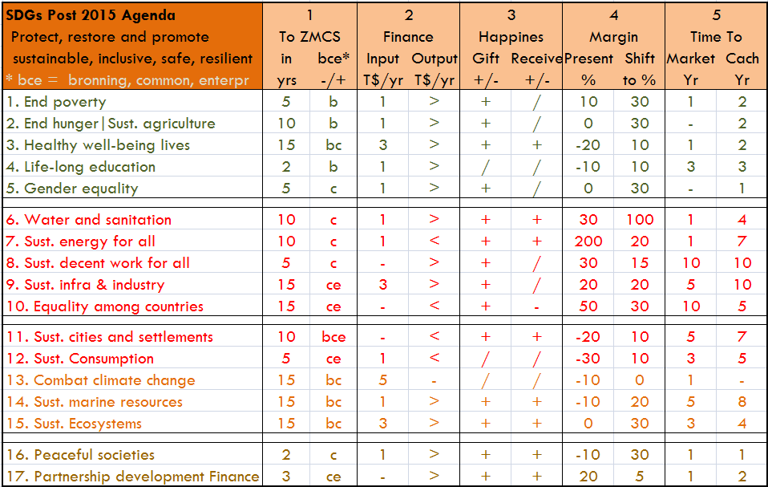
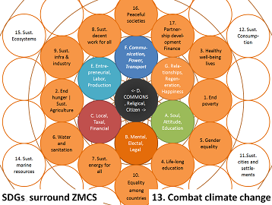
SDGs Financial & Happiness Analyses
worldsustainabilityfund.nl

Slide 32
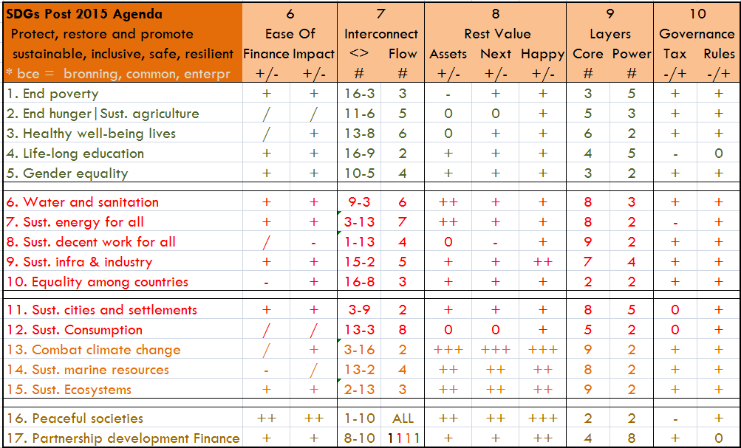
SDGs Financial & Happiness Analyses
worldsustainabilityfund.nl

Slide 33
Setup The four types of income
Own land income:
  Self housing, harvest, creativity, rest & happiness
Community income:
  Mutual services as youth, education & elder care
Social income:
  Mutual work on, and use of, common structures
Commercial income:
  Rest time free labor creativity, prosuming & sales
Philanthropic income:
  Give away & Free receive of over values & happiness
worldsustainabilityfund.nl

Slide 34
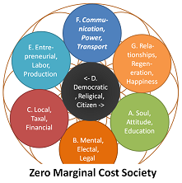
Bronning and Commons aspects
Own land income:
  Land sphere as own Bron of existence
Community income & 3. Social income:
  Common labor power as shared Bron of support
Commercial income:
  Individual and group activities for common luxury and wealth creation with circular sometimes use against payment of natural resources: crea Bronning
Philanthropic income:
  Free Bronning
worldsustainabilityfund.nl

Slide 35
Bronning income on finance
Own land income: Low +/- tax for land value inequality compensation; hours, installation and harvest based
Community income: Get hours, make hours, get hours; for all ages, care, education, buddy; No tax, local admin
Social income: Middle tax in hours or money; p.e. get 80, pay 100, to compensate non hour cost and unabled
Commercial income: Turn-over added value tax, to support general cost, wealth spread, and conservation
Philanthropic income: No or low tax, in split or money; tax for registration, wealth spread, and circular economy
The society becomes less financial and more laboral
worldsustainabilityfund.nl

Slide 36
Global Financial & Tax Blueprint
Implement Land and Community income for
  unemployed, setup support and admin, will create more services, health and happiness, kick starts poverty alleviation
Shift step by step to more social production and income by setup of support, offer easy to transfer jobs; offer financial equivalent consumption possibilities; quote needs
Transit to one equal labor hour rate for each level of education and job heaviness; it makes global commerce prices more equal, which spread jobs and lower transport
All this will lead to lower tax and lean finance
worldsustainabilityfund.nl

Slide 37
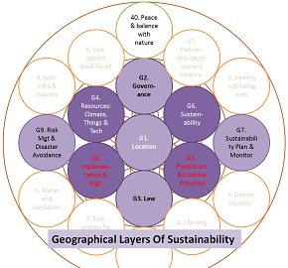
Commons GLOS action on Finance
Value Own land lots and make them free for transition, realize the infrastructure
Allow federations to setup their own Bronning and Commons admin, integrate systems
Plan the impact on financial institutions, prepare them for reorganization
Restrict sustainable use and natural rest value
Create Own land based pension reserves
worldsustainabilityfund.nl

Slide 38
Q & A

Slide 39
Emile van Essen
Email: emile@worldsustainabilityfund.nl
Skype: sbfemile, Tel: +31 6 1925 2628
worldsustainabilityfund.nl

Slide 40

Emile van Essen - WSF

Slide 41
Emile van Essen
Email: emile@worldsustainabilityfund.nl
Skype: sbfemile, Tel: +31 6 1925 2628
worldsustainabilityfund.nl

